Slide 1
SimplyRhino, London
February 12-14,2020
Python Scripting for
Rhino/Grasshopper
Day 3 – Part 2
Long Nguyen

Slide 2
Camera

Slide 3
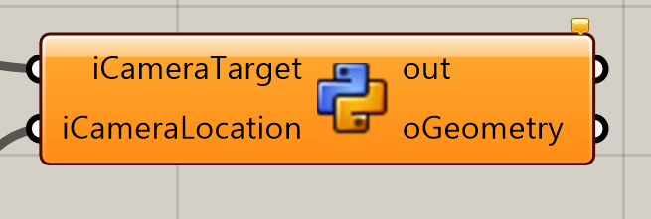
Example: setting camera position and direction
Please open file Camera.gh
import Rhino
activeViewport = Rhino.RhinoDoc.ActiveDoc.Views.ActiveView.ActiveViewport
activeViewport.SetCameraLocations(iCameraTarget, iCameraLocation)

Slide 4
Geometric Intersections

Slide 5
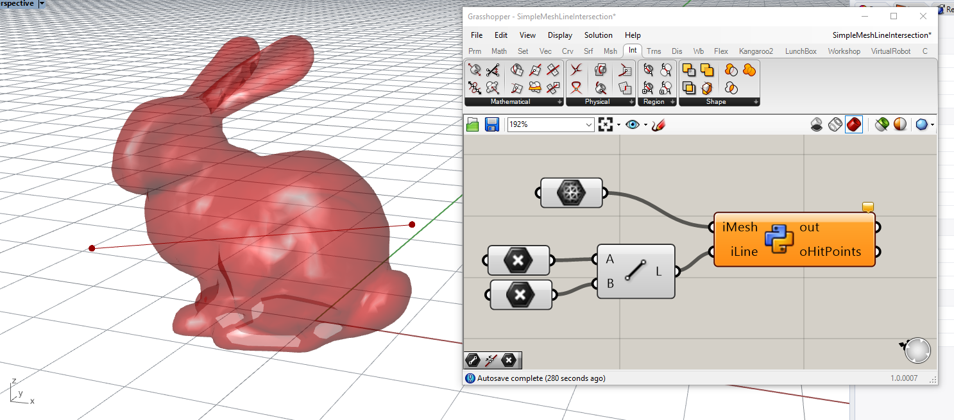
Example: intersections between a line and a mesh
Please open file SimpleMeshLineIntersections.gh
import Rhino.Geometry as rg
from Rhino.Geometry.Intersect import Intersection
result = Intersection.MeshLine(iMesh, iLine)
oHitPoints = result[0]

Slide 6
Persistent data

Slide 7
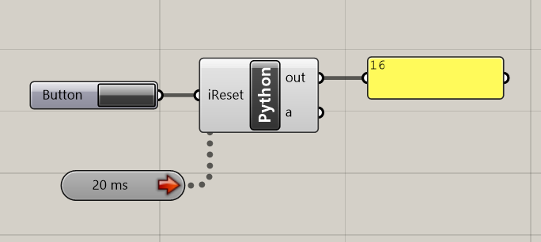
Persistent data: A simple example
if iReset:
m = 0
else:
m += 1
print m
Notice that the value of the variable m is retained after each run of the Python component!

Slide 8
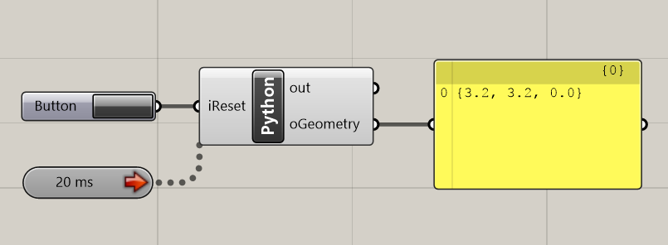
Persistent data: Animating geometries !
import Rhino.Geometry as rg
if iReset:
movingPoint = rg.Point3d(0, 0, 0)
else:
movingPoint += rg.Vector3d(0.1, 0.1, 0.0)
oGeometry = movingPoint

Slide 9
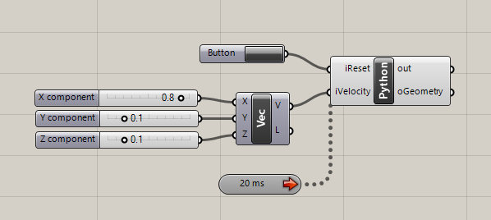
Even better: Interactive animation !!!
import Rhino.Geometry as rg
if iReset:
movingPoint = rg.Point3d(0, 0, 0)
else:
movingPoint += iVelocity
oGeometry = movingPoint

Slide 10
Live Example: Interactive mesh painting (using the mouse)

Slide 11
Live Example: “Particle” System

Slide 12
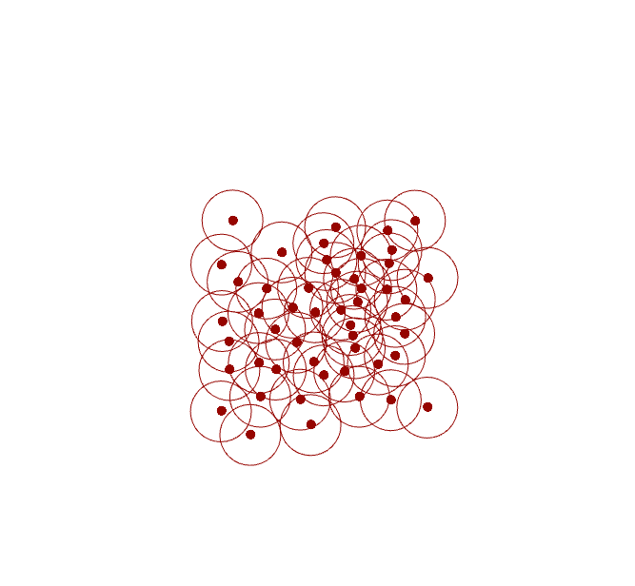
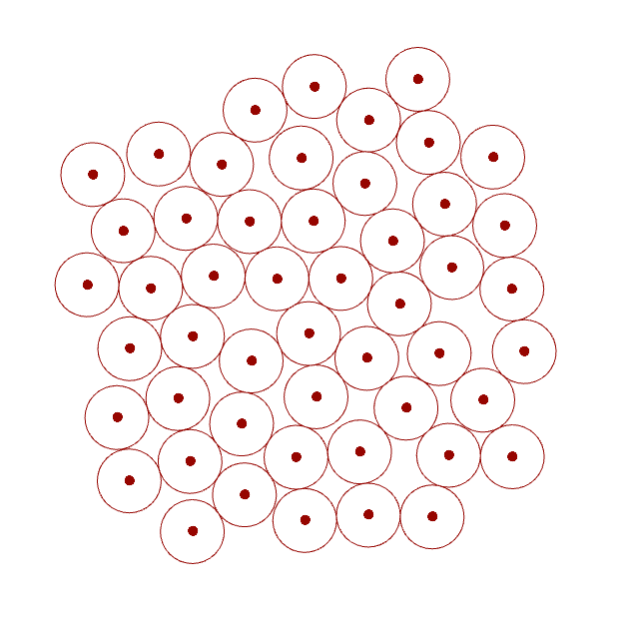
Circle Relaxation
Circles overlapping
No more overlapping

Slide 13
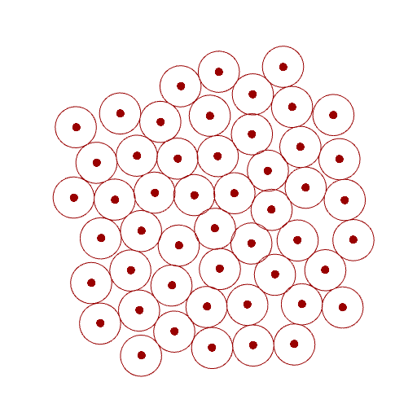
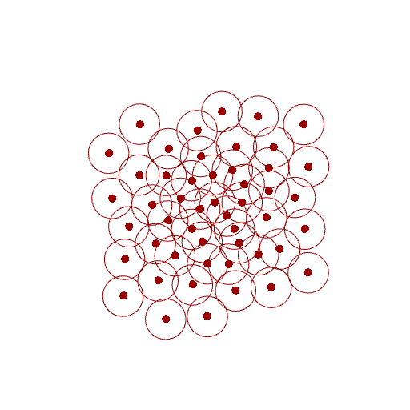
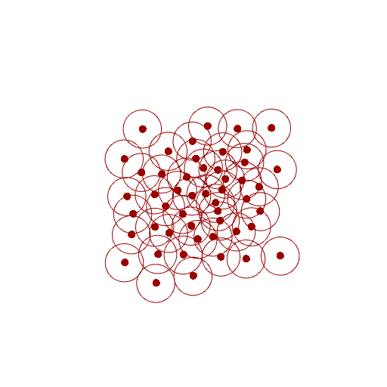
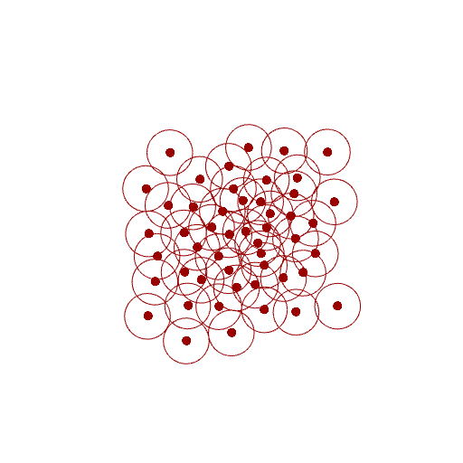
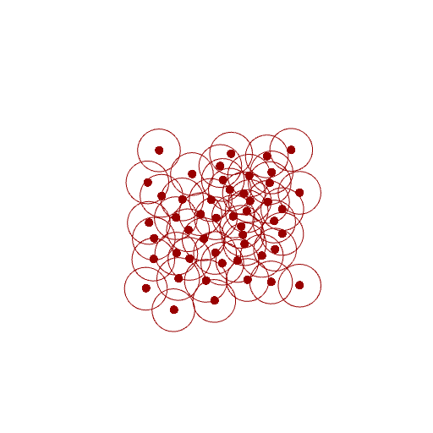
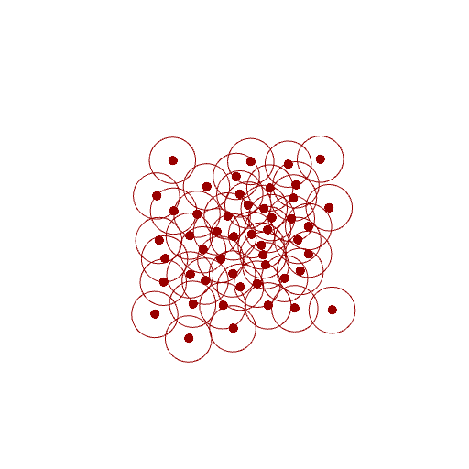
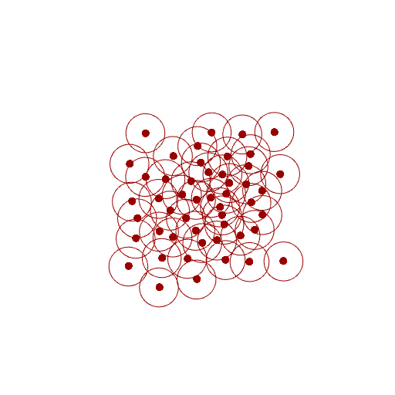
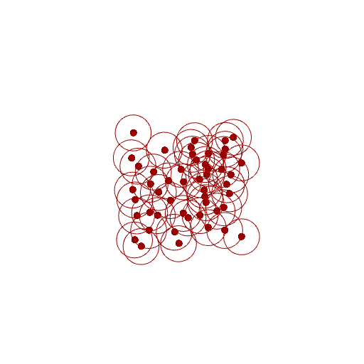


Relaxation:
Iteratively push the overlapping circles away from each other
Iteration 0
1
2
3
4
5
6
7
…
17
…
100

Slide 14
Super simple if there only 2 circles
Need only 1 iteration

Slide 15
If there are more than 2 circles:
Step 1: Consider each pair of circles and calculate the move vectors to push them apart.

Slide 16
If there are more than 2 circles:
Step 2: Compute the AVERAGE move vector for each circle

Slide 17
If there are more than 2 circles:
Step 3: Move each circle according to its AVERAGE move vector.

Slide 18
If there are more than 2 circles:
Notice how the overlapping has been slightly reduced!

Slide 19
If there are more than 2 circles:
Repeat the entire process many times
until there is near 0 overlapping

Slide 20
Object-Oriented Programming

Slide 21
Data types
Built-in Python types: int, float, str, bool, list
Externally-defined types: Point3d, Vector3d, Curve, Mesh
import Rhino.Geometry as rg
myMesh = rg.Mesh()
myPoint = rg.Point3d(0.2, 3, 4.2)
How about:
Our own custom data types?

Slide 22
Example: The “Pyramid” data type
import Rhino.Geometry as rg
class Pyramid:
def __init__(self):
self.BaseFrame = rg.Plane.WorldXY
self.Width = 1.0
self.Length = 1.0
self.Height = 1.0
M
Z
D
C
Y
A
X
B

Slide 23
Example: The “Pyramid” data type
import Rhino.Geometry as rg
class Pyramid:
def __init__(self):
self.BaseFrame = rg.Plane.WorldXY
self.Width = 1.0
self.Length = 1.0
self.Height = 1.0
# Main Script:
myPyramid = Pyramid()
print myPyramid.Width
myPyramid.Height = 2
print myPyramid.Height
yourPyramid = Pyramid()
yourPyramid.Length = 2
yourPyramid.Width = 6
yourPyramid.Height = 4
myPyramid
(type: Pyramid)
yourPyramid
(type: Pyramid)
BaseFrame
BaseFrame
Plane.WorldXY
Plane.WorldXY
Width
Width
# Similar to:
myMesh = rg.Mesh()
1.0
6.0
1.0
Length
Length
1.0
1.0
2.0
Height
Height
2.0
1.0
4.0
1.0

Slide 24
Constructor with parameters
# Similar to:
myMesh = rg.Point3d(3.1, 2.0, 3.0)
myPyramid
(type: Pyramid)
yourPyramid
(type: Pyramid)
BaseFrame
BaseFrame
import Rhino.Geometry as rg
class Pyramid:
def __init__(self, baseFrame, width, length, height):
self.BaseFrame = baseFrame
self.Width = width
self.Length = length
self.Height = height
# Main Script:
myPyramid = Pyramid(rg.Plane.WorldXY, 2, 6, 4)
yourPyramid = Pyramid(rg.Plane.WorldYZ, 8, 2, 5)
print myPyramid.Length
print yourPyramid.Length
Plane.WorldXY
Plane.WorldXY
Width
Width
2.0
8.0
Length
Length
6.0
2.0
Height
Height
4.0
5.0
2
8

Slide 25
A data type has a set of pre-defined methods:
import Rhino.Geometry as rg
myLine = rg.Line(...)
myLine.PointAt(0.3)

Slide 26
Defining the method GetVolume for our Pyramid class
import Rhino.Geometry as rg
class Pyramid:
def __init__(self, baseFrame, width, length, height):
self.BaseFrame = baseFrame
self.Width = width
self.Length = length
self.Height = height
def GetVolume(self):
return self.Width * self.Height * self.Length / 3
# Main Script:
myPyramid = Pyramid(rg.Plane.WorldXY, 2, 6, 4)
yourPyramid = Pyramid(rg.Plane.WorldYZ, 8, 2, 5)
print myPyramid.GetVolume()
print yourPyramid.GetVolume()

Slide 27
Computing the edge lines of the pyramid
import Rhino.Geometry as rg
class Pyramid:
def __init__(self, baseFrame, width, length, height):
self.BaseFrame = baseFrame
self.Width = width
self.Length = length
self.Height = height
...
def GetEdges(self):
A = self.BaseFrame.Origin - self.BaseFrame.XAxis * 0.5 * self.Width + self.BaseFrame.YAxis * 0.5 * self.Length
B = self.BaseFrame.Origin + self.BaseFrame.XAxis * 0.5 * self.Width + self.BaseFrame.YAxis * 0.5 * self.Length
C = self.BaseFrame.Origin + self.BaseFrame.XAxis * 0.5 * self.Width - self.BaseFrame.YAxis * 0.5 * self.Length
D = self.BaseFrame.Origin - self.BaseFrame.XAxis * 0.5 * self.Width - self.BaseFrame.YAxis * 0.5 * self.Length
M = self.BaseFrame.Origin + self.BaseFrame.ZAxis * self.Height
edges = []
edges.append(rg.Line(A, B))
edges.append(rg.Line(B, C))
edges.append(rg.Line(C, D))
edges.append(rg.Line(D, A))
edges.append(rg.Line(A, M))
edges.append(rg.Line(B, M))
edges.append(rg.Line(C, M))
edges.append(rg.Line(D, M))
return edges
# Main Script:
myPyramid = Pyramid(rg.Plane.WorldXY, 2, 6, 4)
oEdges = myPyramid.GetEdges()
M
Z
D
C
Y
A
X
B

Slide 28
A method can modify the values stored in the properties
import Rhino.Geometry as rg
myVector = rg.Vector3d(2, 2, 2)
myVector.Unitize()
print myVector.X

Slide 29
A method can modify the values stored in the properties
import Rhino.Geometry as rg
class Pyramid:
def __init__(self, baseFrame, width, length, height):
self.BaseFrame = baseFrame
self.Width = width
self.Length = length
self.Height = height
...
def Scale(self, scaleFactor):
self.Length *= scaleFactor
self.Width *= scaleFactor
self.Height *= scaleFactor
# Main Script:
myPyramid = Pyramid(rg.Plane.WorldXY, 2, 6, 4)
myPyramid.Scale(2.5)
print myPyramid.Length

Slide 30
A method can create a brand new object of the same class
yourBrep = myBrep.Duplicate()

Slide 31
A method can create a brand new object of the same class
import Rhino.Geometry as rg
class Pyramid:
def __init__(self, baseFrame, width, length, height):
self.BaseFrame = baseFrame
self.Width = width
self.Length = length
self.Height = height
...
def Duplicate(self):
newPyramid = Pyramid(self.BaseFrame, self.Width, self.Length, self.Height)
return newPyramid
# Main Script:
myPyramid = Pyramid(rg.Plane.WorldXY, 2, 6, 4)
yourPyramid = myPyramid.Duplicate()

Slide 32
Within a class, a method can call another method
import Rhino.Geometry as rg
class Pyramid:
def __init__(self, baseFrame, width, length, height):
self.BaseFrame = baseFrame
self.Width = width
self.Length = length
self.Height = height
...
def GetVolume(self):
return self.Width * self.Height * self.Length / 3
def ComputeDensity(self, mass):
volume = self.GetVolume()
return mass / volume;
# Main Script:
myPyramid = Pyramid(rg.Plane.WorldXY, 2, 6, 4)
print myPyramid.ComputeDensity(4.5)

Slide 33
We can send a Pyramid object into a function/method
import Rhino.Geometry as rg
class Pyramid:
...
def CreateLineBetweenTwoPyramid(pyramidA, pyramidB):
topA = pyramidA.BaseFrame.Origin + pyramidA.BaseFrame.ZAxis * pyramidA.Height
topB = pyramidB.BaseFrame.Origin + pyramidB.BaseFrame.ZAxis * pyramidB.Height
return rg.Line(topA, topB)
# Main Script:
myPyramid = Pyramid(rg.Plane.WorldXY, 2, 6, 4)
yourPyramid = Pyramid(rg.Plane(rg.Point3d(20, 10, 0)), 2, 6, 4)
connectingLine = CreateLineBetweenTwoPyramid(myPyramid, yourPyramid)

Slide 34
Live Example: Wandering Particles

Slide 35
A simple class that describes moving particles
import Rhino.Geometry as rg
class Particle:
def __init__(self):
self.Position = rg.Point3d.Origin
self.Velocity = rg.Vector3d(0.1, 0.1, 0.0)
def Update(self):
self.Position += self.Velocity
# Main Script:
if iReset:
myParticle = Particle()
else:
myParticle.Update()
oGeometry = myParticle.Position

Slide 36
Applying random change to velocity
import Rhino.Geometry as rg
import random
class Particle:
def __init__(self):
self.Position = rg.Point3d.Origin
self.Velocity = rg.Vector3d(0.1, 0.1, 0.0)
def Update(self):
self.Velocity.Rotate(random.uniform(-0.2, 0.2), rg.Vector3d.ZAxis)
self.Position += self.Velocity
# Main Script:
if iReset:
myParticle = Particle()
else:
myParticle.Update()
oGeometry = myParticle.Position

Slide 37
Record the position history
import Rhino.Geometry as rg
import random
class Particle:
def __init__(self):
self.Position = rg.Point3d.Origin
self.Velocity = rg.Vector3d(0.1, 0.1, 0.0)
self.History = [self.Position]
def Update(self):
self.Velocity.Rotate(random.uniform(-0.2, 0.2), rg.Vector3d.ZAxis)
self.Position += self.Velocity
self.History.append(self.Position)
# Main Script:
if iReset:
myParticle = Particle()
else:
myParticle.Update()
oGeometry = myParticle.Position
oGeometry = myParticle.History

Slide 38
Draw the travelling path
import Rhino.Geometry as rg
import random
class Particle:
def __init__(self):
self.Position = rg.Point3d.Origin
self.Velocity = rg.Vector3d(0.1, 0.1, 0.0)
self.History = [self.Position]
def Update(self):
self.Velocity.Rotate(random.uniform(-0.2, 0.2), rg.Vector3d.ZAxis)
self.Position += self.Velocity
self.History.append(self.Position)
# Main Script:
if iReset:
myParticle = Particle()
else:
myParticle.Update()
oGeometry = myParticle.History
oGeometry = rg.PolylineCurve(myParticle.History)

Slide 39
Let’s have two particles instead of one!
import Rhino.Geometry as rg
import random
class Particle:
...
# Main Script:
if iReset:
myParticle = Particle()
yourParticle = Particle()
else:
myParticle.Update()
yourParticle.Update()
oGeometry = rg.Polyline(List[rg.Point3d](myParticle.History))
paths = []
paths.append(rg.PolylineCurve(myParticle.History)))
paths.append(rg.PolylineCurve(yourParticle.History)))
oGeometry = paths

Slide 40
10-minute extension exercise
Let’s have plenty (30) of particles

Slide 41
Advanced concepts in Object-Oriented Programming

Slide 42
Inheritance

Slide 43
class LandAnimal:
def __init__(self, weight, legCount):
self.Name = “ “
self.Weight = weight
self.LegCount = legCount
def Eat(self):
...
Inherit
Inherit
class Dog(LandAnimal):
def __init__(self, name, weight, breed):
self.Name = name
self.Weight = weight
self.Breed = breed
self.LegCount = 4
def Bark(self):
...
class Human(LandAnimal):
def __init__(self, name, weight, nationality):
self.Name = name
self.Weight = weight
self.Nationality = nationality
self.LegCount = 2
def ChangeNationality(self):
...

Slide 44
Inheritance can be indirect and multi-level
class LandAnimal:
...
Inherit
class Human(LandAnimal):
...
Inherit
class Architect(Human):
def __init__(self, ...):
...
def DesignBuilding(self):
...

Slide 45
Some terminologies
class LandAnimal:
...
Dog inherits LandAnimal
Dog is derived from LandAnimal
LandAnimal is the parent class of Dog
base class
Dog is a child class of LandAnimal
derived class
subclass
Inherit
class Dog(LandAnimal):
...

Slide 46
Example of class inheritance in RhinoCommon
Degree, Dimension, Domain
ClosestPoint()
PointAt()
Curve
LineCurve
ArcCurve
NurbsCurve
PolyCurve
Line
Points
Reparametrize()

Slide 47
Example of class inheritance in RhinoCommon
Object
GeometryBase
Curve
Brep
Mesh
Surface
LineCurve
ArcCurve
NurbsCurve
PolyCurve

